Slide 1
Beyond China
Arjun Divecha

Slide 2
In a world of uncertainties, one near certainty
“Beyond China” is a secular trend driven by labor cost increases in China, increasing East/West geopolitical frictions, and increasing corporate focus on supply chain diversification
Geopolitical risks are likely to become more important and harder to predict
The U.S.-China “Economic War” is here to stay – a protracted battle for supremacy in technology, military power, and ideology
The net effect on the emerging asset class is negative given that together, Taiwan and China account for approximately half of the MSCI Emerging index
Memories of Covid-19 AND disruptions caused by climate change are also pushing companies to diversify supply chains
There is no simple one-stop alternative to China
OnShoring, NearShoring, and FriendShoring all present opportunities for investment
We present a strategy to take advantage of these trends, focusing on NearShoring and FriendShoring

Slide 3
Why has China fallen out of favor?
Let’s look at why China succeeded from 1978-2014 and what's changed now?
Demographics – labor force growth has gone from positive to negative as a result of one child policy
Capitalism – Deng set in motion a shift away from state ownership and encouraged private investment. Xi has reversed that trend
Access to global markets – Nixon opened up global markets and WTO massively increased that access. Now both imports and exports are being restricted by the West
Competence – economic decision making shifted from the collective wisdom of the Mandarins to Xi
Covid
Killing the golden geese (a work in progress)
Housing
And the biggest failure of all – Hong Kong

Slide 4
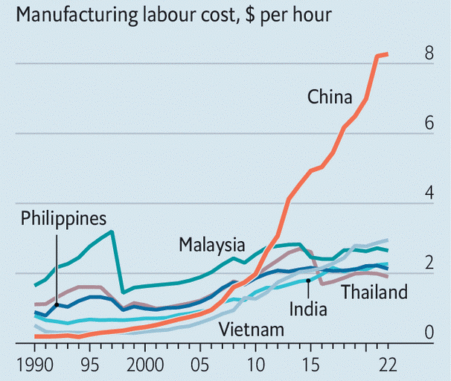
Chinese labor costs Have Risen Steeply
Manufacturing labor cost, $ per hour
Source: The Economist

Slide 5
Corporates are diversifying their supply chains
MENTIONS DURING U.S. CORPORATE PRESENTATIONS OF RE-/NEAR-/ON-SHORING
Source: BofA Global Research, AlphaSense

Slide 6
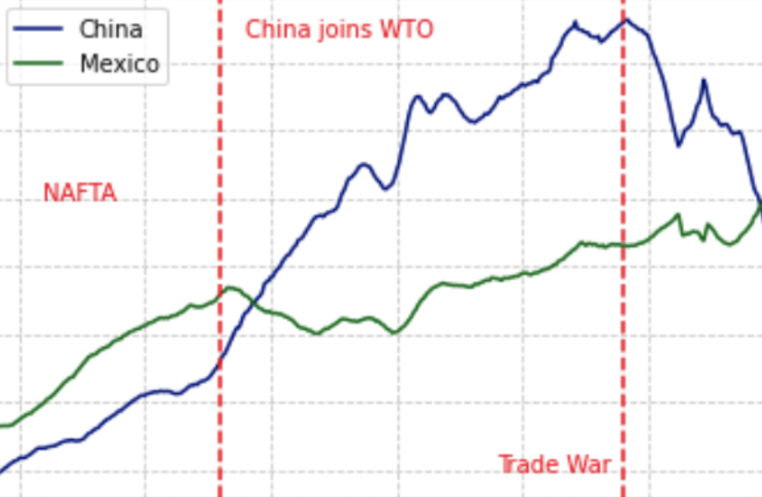
The move is already well under way
SHARE IN TOTAL U.S. GOODS IMPORTS
China joins WTO
20.0
17.5
15.0
NAFTA
Share (%)
12.5
10.0
7.5
5.0
Trade War
1994
1999
2004
2009
2014
2019
Source: XXXX

Slide 7
The move is already well under way
 | China | Mexico | Vietnam | India | Korea | Taiwan | Thailand | Europe
China Peak, 2018 | 21.59 | 13.24 | 1.98 | 2.07 | 2.95 | 1.8 | 1.31 | 18.63
Latest | 14.13 | 14.95 | 3.62 | 2.63 | 3.68 | 2.76 | 1.81 | 18.51
Delta | -7.46 | 1.71 | 1.64 | 0.56 | 0.73 | 0.96 | 0.5 | -0.12
Growth | -34.6 | 12.9 | 82.8 | 27.1 | 24.7 | 53.3 | 38.2 | 0.7
SHARE IN TOTAL U.S. GOODS IMPORTS (%)

Slide 8
Beyond China: country framework
Export Structure in Place
Impact on Economy
Labor & Demographics
Domestic Market Size
Institutional Capacity
Companies Relocating
Source: Bloomberg, GMO

Slide 9
Who benefits from supply chains diversifying out of China?
 | Vietnam | Thailand | Philippines | Indonesia | Bangladesh | India
Registering a New Business | Procedure: 8 steps Time: 17 days Cost: 6% of pc income | Procedure: 5 steps Time: 5 days Cost: 3% of pc income | Procedure: 13 steps Time: 31 days Cost: 20% of pc income | Procedure: 10 steps Time: 20 days Cost: 6% of pc income | Procedure: 9 steps Time: 20 days Cost: 21% of pc income | Procedure: 10 steps Time: 17 days Cost: 15% of pc income
Labor Costs ($U.S./Month) | Min wage: 160 Base Wage: 230 | Min wage: 240 Base Wage: 410 | Min wage: 200 Base Wage: 220 | Min wage: 280 Base Wage: 300 | Min wage: 100 Base Wage: 110 | Min wage: 150 Base Wage: 265
Quality & Availability of Labor | Young and growing population of semi-skilled labour | Easy immigration policies and higher wages attracts labor | Young and a large English-speaking population | Labour skills are not as advanced, but plenty labor availability | Shortage of highly skilled Labor as textile industry employs bulk of the labour | While education levels is good there is shortage of highly skilled
Intellectual Property Protection | Score: 13.81 | Score: 14.50 | Score: 16.20 | Score: 12.87 | Score: NA | Score: 16.22
Construction Permits | Procedure: 10 steps Time: 166 days Quality Score: 12 | Procedure: 19 steps Time: 120 days Quality Score: 11 | Procedure: 23 steps Time: 122 days Quality Score: 13 | Procedure: 17 steps Time: 200 days Quality Score: 13 | Procedure: 16 steps Time: 281 days Quality Score: 10 | Procedure: 20 steps Time: 99 days Quality Score: 14
Getting Electricity & Reliability | Procedure: 4 steps Time: 31 days Reliability Score: 7 | Procedure: 3 steps Time: 30 days Reliability Score: 8 | Procedure: 4 steps Time: 37 days Reliability Score: 6 | Procedure: 4 steps Time: 34 days Reliability Score: 6 | Procedure: 9 steps Time: 150 days Reliability Score: 0 | Procedure: 4 steps Time: 50 days Reliability Score: 7
Trade Across Borders (Hours) | Time to export: 105 | Time to export: 55 | Time to export: 78 | Time to export: 123 | Time to export: 315 | Time to export: 80
Port Facilities (Days) | Duration freight stays in port: 7 | Duration freight stays in port: 7 | Duration freight stays in port: 10 | Duration freight stays in port: 9 | Duration freight stays in port: 16 | Duration freight stays in port: 12
Total Tax & Contribution (% of Profit) | 38% | 30% | 43% | 30% | 33% | 52%
Enforcing Contracts | Days resolving dispute: 400 Cost (% of claim value): 29 | Days resolving dispute: 420 Cost (% of claim value): 17 | Days resolving dispute:962 Cost (% of claim value): 31 | Days resolving dispute:390 Cost (% of claim value): 74 | Days resolving dispute:1,442 Cost (% of claim value): 67 | Days resolving dispute:1,445 Cost (% of claim value): 31
Resolving Insolvency | Recovery rate: 21.3% Time (years): 5 | Recovery rate: 69.8% Time (years): 1.5 | Recovery rate: 21.3% Time (years): 2.7 | Recovery rate: 64.8% Time (years): 1.1 | Recovery rate: 29.2% Time (years): 4.0 | Recovery rate: 26.5% Time (years): 4.3
Corruption | CPI Rank : 117 | CPI Rank : 99 | CPI Rank : 99 | CPI Rank : 89 | CPI Rank : 149 | CPI Rank : 78
Source: World Bank, Ease of Doing Business, GMO research

Slide 10
Institutions in Emerging Markets
Shaping the future or derailing progress?
Country | Electricity Supply | Transportation Infrastructure | Tax Policy | Governance | Doing Business | Industrial Space | FTAs with U.S./EU | Institutional Capacity
Korea |  |  |  |  |  |  |  | 1.0
Czech Republic |  |  |  |  |  |  |  | 0.9
United Arab Emirates |  |  |  |  |  |  |  | 0.9
Poland |  |  |  |  |  |  |  | 0.8
Chile |  |  |  |  |  |  |  | 0.7
South Africa |  |  |  |  |  |  |  | 0.2
Kuwait |  |  |  |  |  |  |  | 0.2
Egypt |  |  |  |  |  |  |  | 0.1
Brazil |  |  |  |  |  |  |  | 0.0
Philippines |  |  |  |  |  |  |  | 0.0
TOP
BOTTOM
Source: GMO

Slide 11
A Closer Look at the Most attractive countries
Source: GMO

Slide 12
Institutions in Emerging Markets
Institutional quality assessment
Source: GMO

Slide 13
Beyond China: country framework
Export Structure in Place
Impact on Economy
Labor & Demographics
Domestic Market Size
Institutional Capacity
Companies Relocating
Czech Republic
Poland
Vietnam
Thailand
Mexico
Vietnam
Malaysia
Czech Republic
Hungary
Poland
India
Indonesia
Brazil
Philippines
Mexico
India
Indonesia
Brazil
Mexico
Philippines
South Korea
Czech Republic
UAE
Poland
Chile
Vietnam
Mexico
Thailand
India
Philippines
TOP
Peru
Saudi Arabia
Chile
Kuwait
Qatar
Kuwait
Peru
Chile
Brazil
Colombia
Czech Republic
Qatar
Kuwait
South Korea
Greece
Czech Republic
Hungary
UAE
Kuwait
Qatar
South Africa
Kuwait
Egypt
Brazil
Philippines
Saudi Arabia
Peru
Colombia
Kuwait
Qatar
BOTTOM
Source: Bloomberg, GMO

Slide 14
Most and least attractive countries
Who benefits from a China manufacturing exodus?
Export Structure in Place
Impact on Economy
Labor & Demographics
Domestic Market Size
Institutional Capacity
Companies Relocating
+
+
+
+
+
Kuwait
Chile
Saudi Arabia
Thailand
Vietnam
Qatar
Colombia
Indonesia
India
Mexico

Slide 15
Top and Bottom countries on this metric
Final Score |  |  | Final Score
Vietnam | 1.00 |  | Hungary | 0.45
Thailand | 0.95 |  | Brazil | 0.40
Mexico | 0.90 |  | South Africa | 0.35
India | 0.80 |  | United Arab Emirates | 0.30
Poland | 0.80 |  | Saudi Arabia | 0.25
Czech Republic | 0.75 |  | Peru | 0.20
Philippines | 0.70 |  | Colombia | 0.15
Malaysia | 0.65 |  | Chile | 0.10
Indonesia | 0.55 |  | Kuwait | 0.05
Korea | 0.55 |  | Qatar | 0.00
Turkey | 0.50

Slide 16
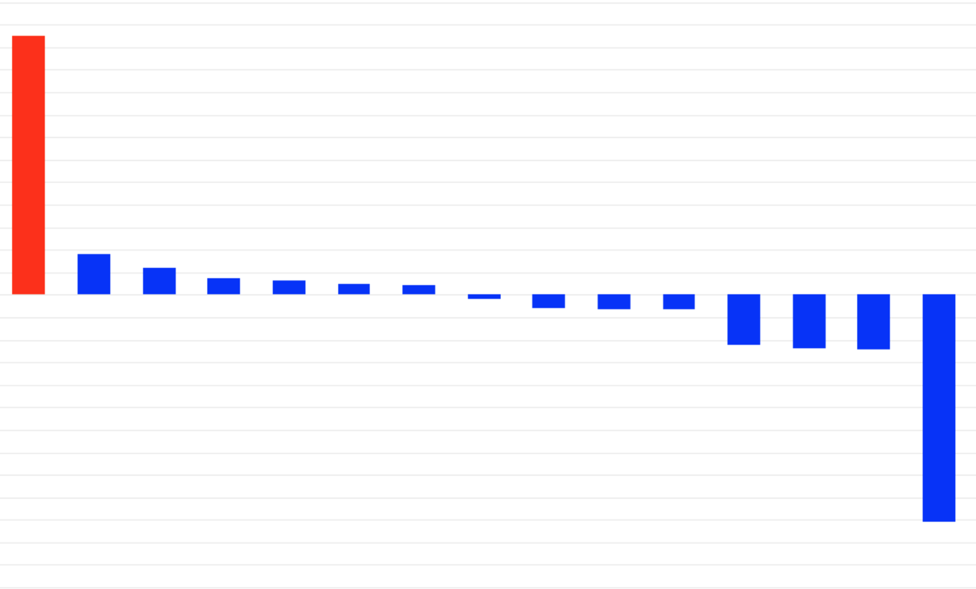
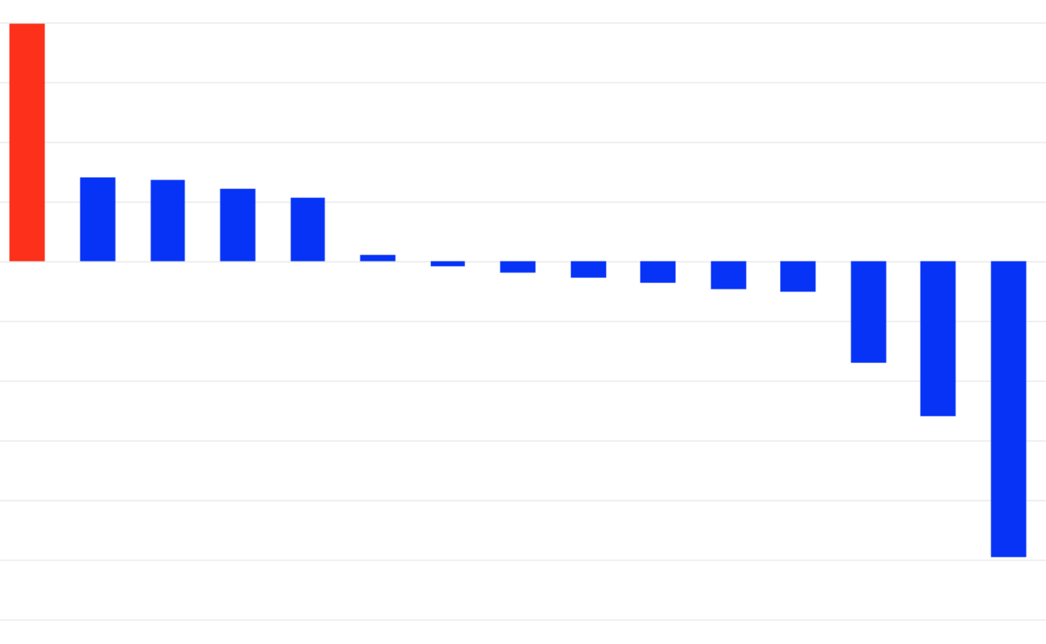
Assessing “friend-shoring”
Supply chain-based exposure analysis
VIETNAM
MEXICO
6
2
4
1
2
0
0
Market Share Change
Market Share Change
-1
-2
-4
-2
-6
-3
CHN
AUS
IDN
BRA
TWN
IND
USA
ARG
HKG
DEU
MYS
JPN
SGP
THA
KOR
CHN
TWN
BRA
VNM
MYS
IND
KOR
THA
CAN
ITA
FRA
ESP
DEU
JPN
USA
Source: Global Supply Chains: The Looming “Great Reallocation” by Laura Alfaro and David Chor

Slide 17
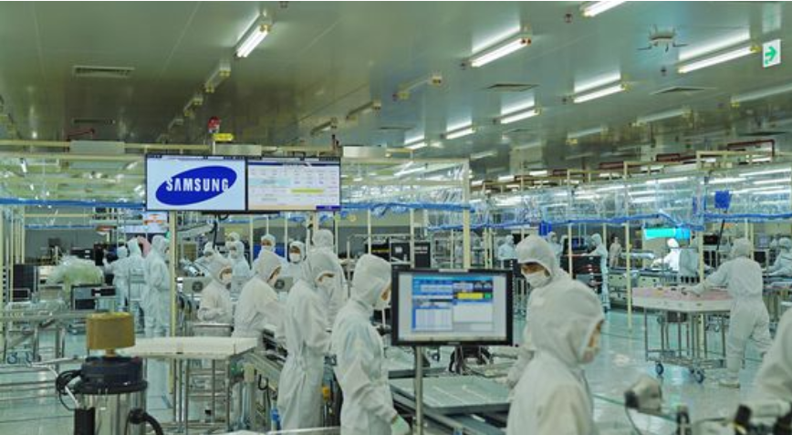
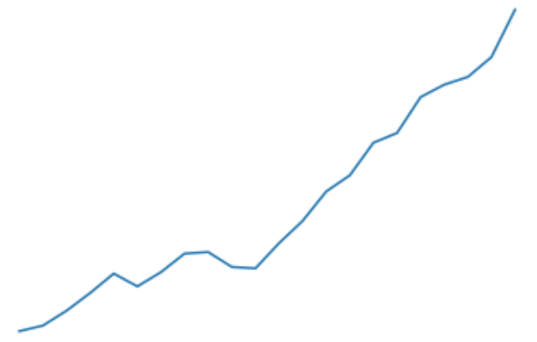
WHY Vietnam?
Strong economic growth with a thriving middle class
Low labor costs, young population, and high productivity growth
Friendly government with a high number of approved FTAs
Heavy investment in infrastructure development
Supportive economic fundamentals with low inflation and healthy external balances
Stable political environment for reliable business operations
Strategic location in Southeast Asia for tapping into growing markets
Geographically close and culturally connected to China
VIETNAM MANUFACTURING EXPORTS AS % OF GDP
80
70
60
50
40
30
20
2000
2005
2010
2015
2020
Source: World Bank, GMO

Slide 18
Vietnam: ONE OF THE MOST SIMILAR EXPORTS TO CHINA

Slide 19
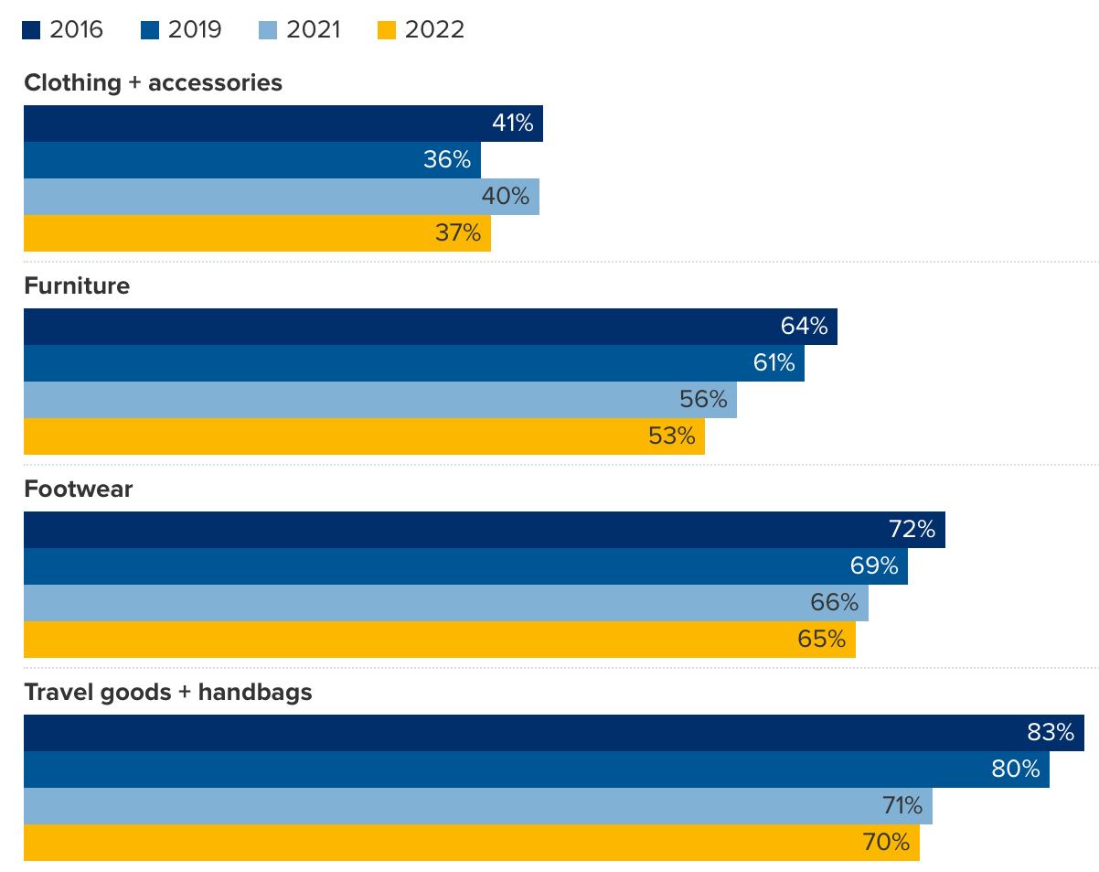
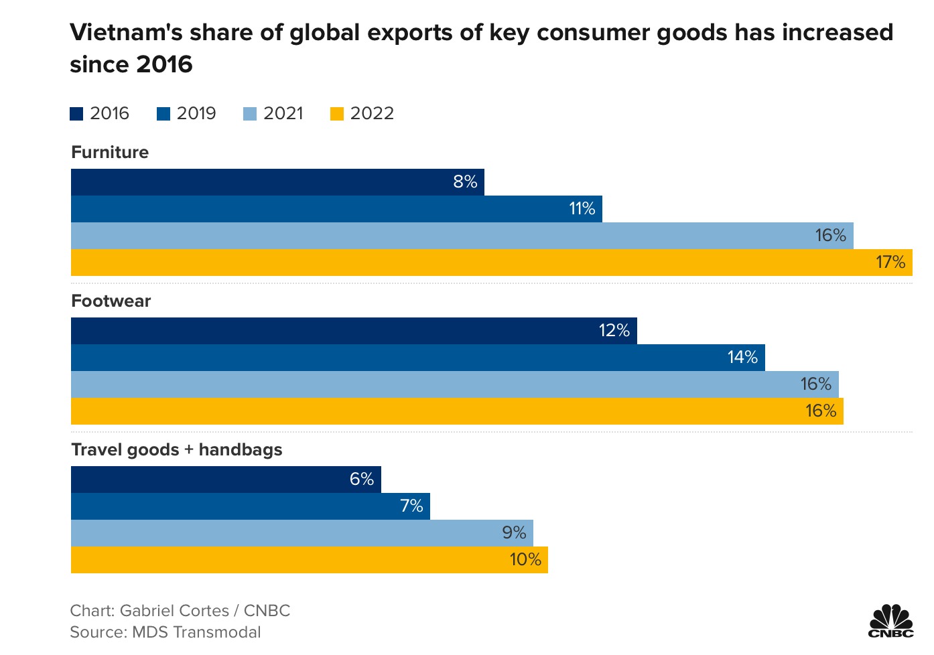
Vietnam has already taken significant market share in certain industries
CHINA’S SHARE OF GLOBAL EXPORTS OF CONSUMER GOOD HAS FALLEN SINCE 2016
VIETNAM’S SHARE OF GLOBAL EXPORTS OF KEY CONSUMER GOODS HAS INCREASED SINCE 2016
Charts: Gabriel Cortes/CNBC | Source: MDS Transmodal

Slide 20
Mexico: attractive top-down view
Favorable top-down indicators:
Stable macro-economic indicators with low vulnerability on current and fiscal accounts
Functional democracy with Independent Central Bank and other institutions
High real rates boosting currency and carry trade
Steady and consistent growth in remittances reaching 4% of GDP in 2022
FDI growth in double digits in 2022 reaching $35 billion (USD) with strong pipeline
Nearshoring likely to boost GDP growth by 50 to 100 bps per annum over medium term

Slide 21
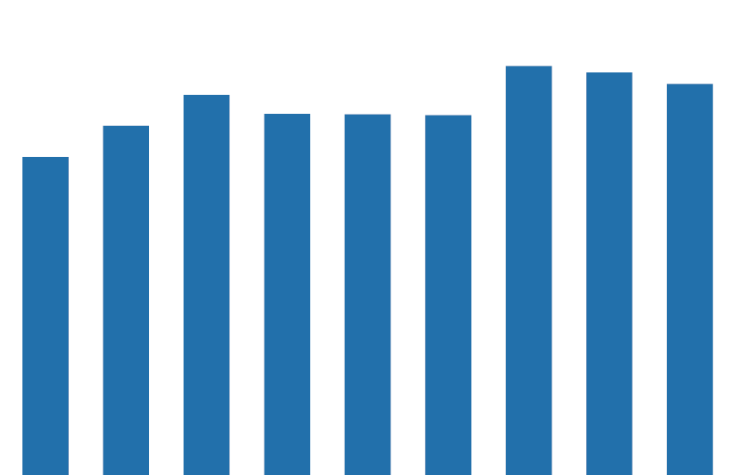
Steady government debt-to-GDP Ratio
MEXICO GROSS PUBLIC DEBT-TO-GDP (%)
60%
50%
40%
30%
20%
10%
0%
2014
2016
2018
2020
2022
Source: Morgan Stanley, Mexico government

Slide 22
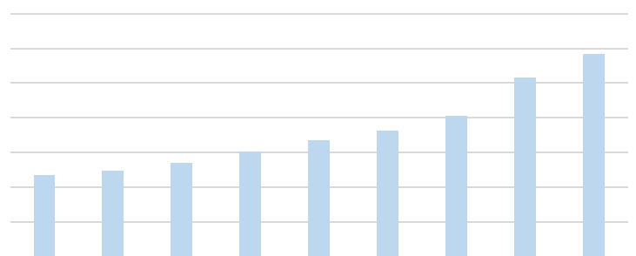
steady growth in remittances to Mexico
MEXICO REMITTANCES
70,000
60,000
50,000
$ Millions (USD)
40,000
30,000
20,000
10,000
0
2014
2015
2016
2017
2018
2019
2020
2021
2022
Source: Mexico Central Bank

Slide 23
Nearshoring: Mexico’s moment
Mexico’s advantage in nearshoring:
Large border running more than 3,000 kilometers with the U.S., the world’s largest consumer economy
Rule-based trade framework in the form of USMCA and 13 other FTAs including the EU and Japan
Well-established manufacturing facilities, supply chains, and trade linkages
Relatively better ranking on economic complexity and IP protection
Labor costs significantly lower than the U.S. and China
Rapid progression as top trading partner with the U.S. with further scope to gain share

Slide 24
Well-evolved supply chain
ECONOMIC COMPLEXITY RANK 2019
Source: XXXX

Slide 25
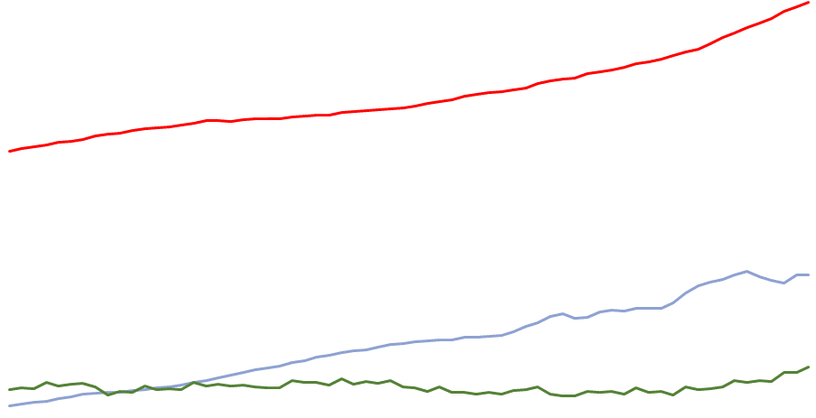
Mexico Labor costs compared to China and the U.S.
AVERAGE MANUFACTURING LABOR COSTS
U.S.
26.2
25
20
15
China
10
9.5
5
Mexico
3.8
0
1Q 2007
1Q 2010
1Q 2013
1Q 2016
1Q 2019
1Q 2022
As of 3/31/22 | Source: XXXX

Slide 26
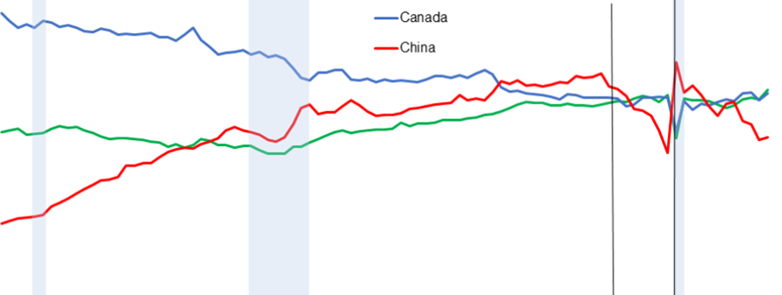
Mexico: Top overall trading partner with the U.S.
Mexico becomes top U.S. trading partner at start of 2023
SHARE OF TOTAL U.S. TRADE
U.S. tariffs on Chinese exports announced
Covid-19 pandemic begins
25%
20%
15%
10%
5%
0%
2000
2002
2004
2006
2008
2010
2012
2014
2016
2018
2020
2022
Mexico
Canada
China
Source: Census Bureau, Federal Reserve Bank of Dallas
Data is seasonally adjusted and quarterly. Figures also include April 2023. Shaded area denotes a recession. Total trade is the sum of exports and imports.

Slide 27
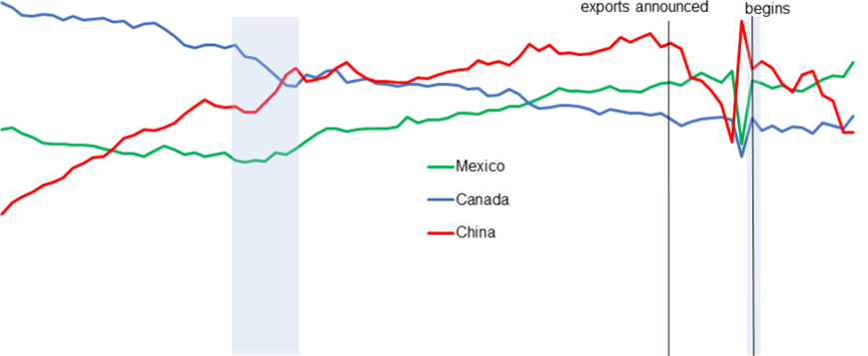
Mexico: Top manufacturing trade partner
Mexico surpasses China as the main U.S. manufacturing trading partner
U.S. tariffs on Chinese exports announced
Covid-19 pandemic begins
SHARE OF TOTAL U.S. MANUFACTURING TRADE
20%
15%
10%
5%
0%
2002
2004
2006
2008
2010
2012
2014
2016
2018
2020
2022
Mexico
Canada
China
Source: Census Bureau, Federal Reserve Bank of Dallas
Data is seasonally adjusted and quarterly. Figures also include April 2023. Shaded area denotes a recession. Total manufacturing trade is the sum of manufacturing exports and imports.

Slide 28
Where are the best opportunities?
Model exposures by Country Sectors
 | Cons. Discretionary | Cons. Staples | Energy | Financials | Industrials | IT | Materials | Real Estate | Weight Country
Brazil |  |  |  |  |  |  |  |  | 2.4%
Chile |  |  |  |  |  |  |  |  | 2.2%
Czech |  |  |  |  |  |  |  |  | 2.1%
India |  |  |  |  |  |  |  |  | 21.3%
Indonesia |  |  |  |  |  |  |  |  | 6.3%
Korea |  |  |  |  |  |  |  |  | 5.1%
Mexico |  |  |  |  |  |  |  |  | 13.1%
Poland |  |  |  |  |  |  |  |  | 3.5%
Taiwan |  |  |  |  |  |  |  |  | 10.6%
Thailand |  |  |  |  |  |  |  |  | 8.2%
Turkey |  |  |  |  |  |  |  |  | 1.4%
Vietnam |  |  |  |  |  |  |  |  | 14.4%
MNC |  |  |  |  |  |  |  |  | 9.6%
Weight Sector | 12.30% | 3.79% | 1.57% | 16.34% | 24.85% | 19.43% | 11.05% | 10.67%

Slide 29




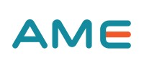

Beyond China: from country to company
Market Share Gain
Higher Demand Industrial Park
Rising Global Capex
Top Down
✓
✓
X
✓
✓
✓
Stock Attractiveness
–
✓
✓
✓
✓
Liquidity
✓
–
X
✓
Final Portfolio
Final Portfolio
Final Portfolio

Slide 30
Tailwinds for Select Emerging and Multinational Companies
Market Share Gain from Chinese Competitors
Higher Economic Growth Due to Nearshoring
Increased Demand of Industrial Park
Companies benefiting from…
Rise in Industrial Activity
Increase in Global Capital Expenditure

Slide 31

Mexico Real Estate: Vesta
Vesta is a fully integrated real estate owner, operator, and developer. It has one of the largest and most modern industrial portfolios in Mexico
THESIS
Exposure to mega trends – nearshoring and e-commerce
Alignment with minority shareholders unlike most other Mexican real estate stocks
Low-cost land bank built ahead of the curve
Stable and diversified client base lowering client concentration and credit risk
Attractive valuations in the context of higher spot rents and expansion plans
Significant advancement in ESG with green certifications for portfolio
Gradual progression from small cap indices to mainstream EM indices

Slide 32
VIETNAM REAL ESTATE EXAMPLE
Kinh Bac City
Kinh Bac City is one of Vietnam’s leading industrial park developers managing more than 5,000 hectares of real estate and is a direct beneficiary of shifting of technology supply chains into Vietnam
THEME What Is the Industry Benefit of MOC?
Real estate industry is a key beneficiary of the MOC theme as companies seek prime land with supporting infrastructure for expansion outside China
Vietnam’s industrial parks in the north gain from developed port facilities in Haiphong and adequate road infrastructure
Vietnam shares land border with China which helps in logistics. Major Korean, Japanese, and Chinese technology companies have been moving production to Vietnam
THEME Good Stock, Specific Benefits to MOC?
Kihn Bac City owns and manages prime industrial estates in Vietnam. Three-fourths of its land holdings are in the North which benefits from a self-sustaining ecosystem of technology and automotive companies and suppliers
With 22 of its existing industrial parks (IP) in operation, Kinh Bac City holds the leading position in attracting FDI, especially large business groups such as Canon, Foxconn, LG, and Goertek
Kinh Bac City has adequate land bank for future growth in IP and urban township development. The company has competitive pricing
Risks include slowdown in FDI inflow, change in IP regulations, and loan limitations to IP developers

Slide 33

Brazil Industrials EXAMPLE
WEG
Founded in Brazil in 1961, WEG is one of the highest growth capital goods companies with number one or number two in all product lines in Latin America. It is one of the best way to invest in mega trends of energy efficiency, renewables, and electrical mobility
THEME What Is the Industry Benefit of MOC?
Shifting of supply chain out of China will require significant investments in capital goods across the globe
World will require products and services that address long term trends around electrification, automation, digitization, and energy efficiency
Significant investments in industrial goods are expected in the U.S., Mexico, Brazil, and the rest of Latin America to meet growing demands under new geopolitical realities
THEME Good Stock, Specific Benefits to MOC?
WEG has a history of achieving revenue CAGR of 18.5% over the past 26 years through organic growth and accretive acquisitions
Complete range of electric products and systems with an integrated one-stop solution
52 manufacturing sites in 15 countries in 4 continents and distributors in more than 120 countries. Globally number 2 market share in low voltage industrial motors
Diversified product lines allows strong growth across different market cycles, segments, and geographies

Slide 34

Thailand Industrials EXAMPLE
Delta Electronics Thai PCL
Originating from Taiwan’s Delta Electronics, Delta Thailand is an electronics exporter/manufacturer of power supplies and electronic components comprising cooling fans, electromagnetic interference (EMI) filters, and solenoids
THEME What Is the Industry Benefit of MOC?
Thailand industrials stand to gain from China plus one strategy of major automobile and manufacturing companies
Thailand’s Eastern Economic Corridor is emerging as a preferred destination for major Chinese auto companies seeking diversification away from China
As more companies move auto and ancillary manufacturing to Thailand, industrials benefit from increased demand for automation and as suppliers
THEME Good Stock, Specific Benefits to MOC?
Delta Thailand’s products are widely used in electric vehicles (EV) and Thailand is fast emerging as a preferred EV destination with major Chinese automakers such as BYD moving in
Delta Thailand has been aggressively growing its solution businesses in EV chargers, industrial automation, data center infrastructure, and energy management
As demand for supply chain localization grows in Thailand, companies like Delta Thailand and Hana Electronics will benefit
Delta Thailand has ample orderbook and its exposure in EV and data centers are multi-year revenue growth drivers

Slide 35
Beyond China Strategy
Model exposures by theme
Theme | Exposure (%)
Higher Economic Growth Due To Nearshoring | 22
Banks | 16
Retailing | 6
Market Share Gain from Chinese Competitors | 32
Tech Hardware | 11
Apparel | 7
Chemical | 6
Consumer Electronics | 3
EV Battery | 2
Construction Materials | 2
Engineering and Construction | 1
Auto Components | 1
Real Estate and Infrastructure | 13
Theme | Exposure (%)
Rise in Industrial Activity | 7
Port and Logistics | 3
Airport | 3
Energy and Power Distributors | 2
Increase in Global Capital Expenditure | 21
Industrial Machinery | 10
Tech H/W Supply Chain | 5
High-end Semiconductor Equipment | 4
Air Conditioning | 2
Shift in Global EV & Renewables Supply Chain | 5
As of 3/31/23
Model portfolio characteristics have many inherent limitations and may not reflect the impact that material economic and market factors may have on the decision-making process if client fund were actually managed in the manner shown. Actual characteristics may differ substantially from the model characteristics presented.

Slide 36
Model Portfolio characteristics
Well diversified across countries and sectors; a benchmark-agnostic approach
COUNTRY WEIGHTS (%)
SECTOR WEIGHTS (%)
GMO Model Portfolio
MSCI Emerging Index
Largest Country Overweights
Vietnam, Mexico, MNC
Largest Sector Overweights
Industrials, Materials, Real Estate
As of 3/31/23 | Source: GICS Sector Report, GMO
Model portfolio characteristics have many inherent limitations and may not reflect the impact that material economic and market factors may have on the decision-making process if client fund were actually managed in the manner shown. Actual characteristics may differ substantially from the model characteristics presented. MSCI data may not be reproduced or used for any other purpose. MSCI provides no warranties, has not prepared or approved this report, and has no liability hereunder. Please visit https://www.gmo.com/americas/benchmark-disclaimers/ to review the complete benchmark disclaimer notice.

Slide 37

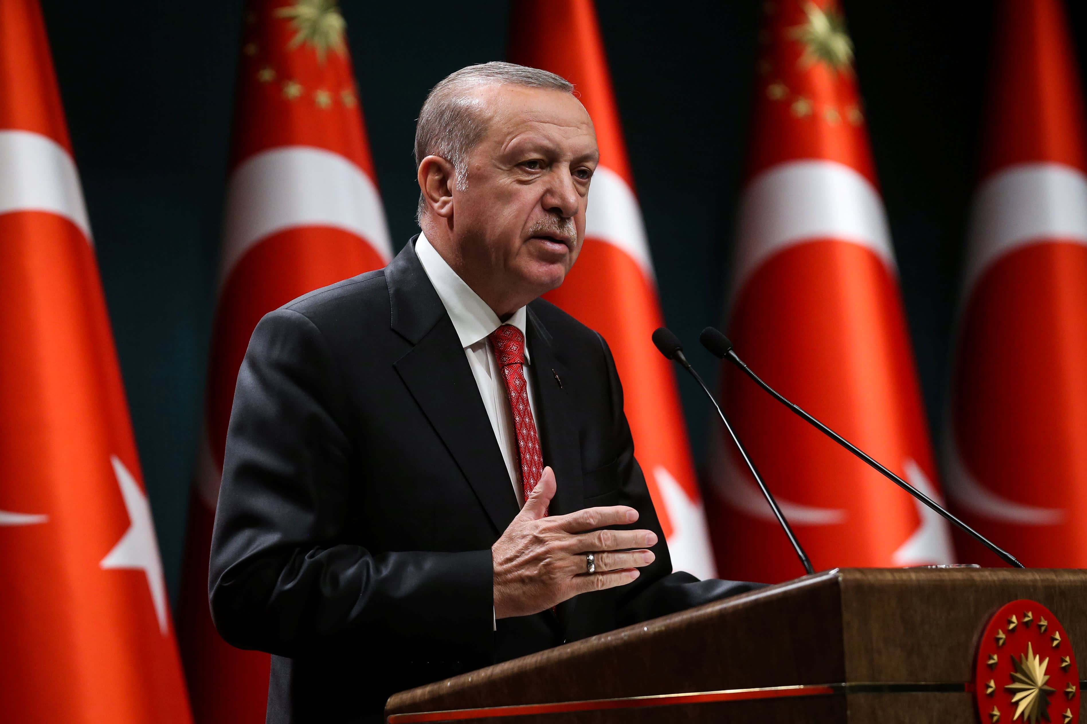
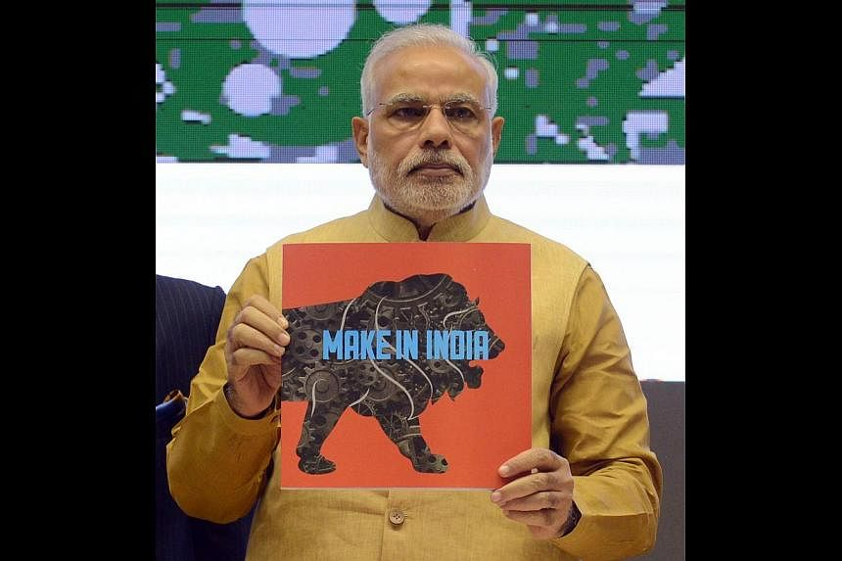
Holding for the Long Term in Emerging Markets
One man can impact investment outcomes
Philippines' investment appeal waned in 2016 as Duterte rose to power
“Turkey’s Still Dealing With the Aftershocks – of Erdogan’s Economy”
– Foreign Policy , April 2023
Make in India: devised to transform India into a global manufacturing hub

Slide 38
Holding for the Long Term in Emerging Markets
One man can impact investment outcomes
What can go wrong?
Geopolitics matters for emerging countries
China vs. U.S., cross-strait relations
Increasing nationalism/populism
Further anti-graft campaign in Vietnam, Trump winning another term in 2024
Still unclear how much “friend-shoring” diversifies out of China as it’s gaining significant market share with “friends”
Vietnam, Mexico, EU
Climate change will have an asymmetric impact on resources
Water availability, materials
Energy and oil security policy

Slide 39
How long will this theme last?
Tech suppliers took 20 to 25 years to build a mature, complete information technology supply chain in China - CIER (Taiwan thinktank)
Given China’s massive size, it will take years of effort by the beneficiaries to absorb even modest slices from China
Mentions on corporate calls have steadily risen. Our analysts confirm that this is typically about future plans
Dynamic landscape: India a recent add to the beneficiary list
Valuations provide upside (returns so far have been driven totally by earnings)
Quality provides support (~40% premium to MSCI EM/MSCI EM ex-China)

Slide 40

The Beyond China journey is in its early stages
We’ve only just begun…
10% of China’s industry exports scale to peers’ current exports
AUTOMOTIVE
HIGH TECH ELECTRONICS & ELECTRICAL
TEXTILES & APPAREL
CHEMICALS
As of 5/31/23 | Source: UNCTAD, GMO

Slide 41
Important information
This presentation has been provided to you by Grantham, Mayo, Van Otterloo & Co. LLC (“GMO”) for illustrative purposes only, is intended exclusively for the use of the person to whom it has been delivered by GMO, and is not to be reproduced or redistributed to any other person. Nothing contained herein constitutes investment, legal, tax, regulatory, accounting or other advice of any kind nor is it to be relied on in making an investment or other decision. This presentation should not be viewed as a current or past recommendation or a solicitation of an offer to buy or sell any securities or to adopt any investment strategy. The investment strategy and themes discussed herein may be unsuitable for investors depending on their specific investment objectives and financial situation.
The information in this presentation is only as current as the date indicated, and may be superseded by subsequent market events or for other reasons. The information in this presentation has been developed internally and/or obtained from sources believed to be reliable; however, GMO does not guarantee the accuracy, adequacy or completeness of such information. The information contained herein may be based on (i) data that may no longer be current, (ii) estimates that may involve highly subjective assessments and (iii) models that may change from time to time and be different from the assumptions and models used by other persons. Such information should not be the basis for determining the value of any security or financial instrument or in making any decision to buy, sell or hold a security or financial instrument. It should not be assumed that GMO will make investment recommendations in the future that are consistent with the views expressed herein, or use any or all of the techniques or methods of analysis described herein in managing client accounts.
There can be no assurance that an investment strategy will be successful. Historic market trends are not reliable indicators of actual future market behavior or future performance of any particular investment which may differ materially, and should not be relied upon as such. Predictions, opinions, and other information contained in this presentation are subject to change continually and without notice of any kind and may no longer be true after the date indicated. [Forward-looking statements are subject to numerous assumptions, risks and uncertainties, which change over time, and GMO assumes no duty to and does not undertake to update forward-looking statements. Any forward-looking statements are not guarantees of any future performance and actual results or developments may differ materially.
The offer to invest in any financial product issued or advised by GMO is contained in the relevant Information Memorandum, Product Disclosure Statement or other offering document and is subject to the conditions set out therein. Offering documents are available from GMO and should be considered before making any investment decisions.
GMO Australia Limited ABN 30 071 502 639, AFSL 236 656

Slide 42

Boston
53 State Street | Boston, Massachusetts 02109 | Tel: +1 617 330 7500
San Francisco
2150 Shattuck Avenue | Suite 900 | Berkeley, California 94704 | Tel: +1 510 649 6030
Europe
Asia-Pacific
GMO UK Limited
No.1 London Bridge, London SE1 9BG
Tel: +44 20 7814 7600 Fax: +44 20 7814 7605
Company Number: 04658801
GMO UK Limited Authorised and Regulated by the Financial Conduct Authority Registered no 4658801 England.
GMO Netherlands B.V. is licensed by the Netherlands Authority for the Financial Markets
GMO Netherlands B.V.
Gustav Mahlerplein 109 – 115, 26th floor | 1082 MS Amsterdam | Tel: +31 (0)20 7085789
GMO Netherlands B.V. is licensed by the Netherlands Authority for the Financial Markets
GMO Australia Limited
P.O. Box R1817, Royal Exchange, NSW 1225 | Suite 43.02, Grosvenor Place, 225 George Street, Sydney NSW 2000
Tel: +61 2 8274 9900 Fax: +61 2 8003 8800
GMO Australia Limited ABN: 30 071 502 639, ASFL No: 236 656
GMO Singapore Pte. Limited
6 Battery Road, #34-01 | Singapore 049909 | Tel: +65 6532.0346
GMO Singapore Pte. Limited UEN No: 20-0301509-R, Capital Markets Services License No: CMS100016
Tokyo (Representative Office)
2-11-1 Nagatacho Chiyoda-ku | Tokyo, Japan 100-6162

Slide 43


Q &A

Slide 44


